Slide 1


Data Analysis on Pharmacy
Data analysis and decision-making based on pharmacy data from 2007-2010
ADTA 5240. Section 103
Group 8:
Tianrun Zhang
Avinash Bodla Vamshi Krishna Reddy Jakkannagari
Sahika Erukulla Sowmya Varanganti
Nouri Hamada

Slide 2

Problem Statement:
Despite producing high-quality products, the company is struggling to maintain its market share and meet its sales targets.

Slide 3
Business Understanding
The overall profit for the U.S. pharmacy industry has decreased from 2007 to 2010, our group has done several analysis from different perspectives to maximize the profit in order retain financial stable.

Slide 4
Data Understanding
We retrieved the data from internal port of UNT Canvas: https://unt.instructure.com/courses/83873/files/20149570?wrap=1

Slide 5
Data Preparation:
We will use BigQuery and OpenRefine to sort and filter the data queries.
Then, we will use Tableau to build visuals on data for better data understanding.

Slide 8
Profit and State Analysis
Overall Profit Analysis: In summary of the profit analysis, even though there was an increase in units sold from 2007 to 2008, the total profit has decreased by 0.3 million dollars. In the subsequent examination, we will produce a set of data analysis to aid in decision making.
State Analysis:
Texas had the highest drug demand in the United States with 11,178 units sold between 2007 and 2010, whereas New York generated the highest total profit of $436,864.
The primary reason why Texas sold more units than New York but earned less profit than New York is due to the variation in the average retail sales price per unit.
Solution: Raise the unit retail sales price in Texas.

Slide 11
Wholesaler Analysis
Wholesaler Analysis:
The profits of three wholesalers reached their highest point in 2007, according to the annual profit report spanning from 2007 to 2010.
With almost $1.1 Million profit in 2007, Wholesaler B emerges as the top performer. As a result, our subsequent analysis will primarily concentrate on Wholesaler B's data in 2007.
The Animal segment is the most profitable segment, accounts for the largest proportion (49%) in the profit composition of Wholesaler B. In the meantime, dosage type Cream has the most profit in the Animal segment.
Solution: To maximize profits, Wholesaler B should consider placing larger orders for the Animal segment.

Slide 13
Pharmacy Representative Analysis
Pharmacy Rep Analysis:
Pharmacy reps Dolly DeCherney sold the most units (3,531 units sold).
Mary Monton, who is one of the top 3 salespersons, sold 111 more units than Bill Barreto. However, despite this, she made $109,652 less profit than him.
Solution: To encourage healthy competition among Sales Reps and increase overall profits, dispatch Mary Monton to Bill Barreto's region or raise the retail price.

Slide 14
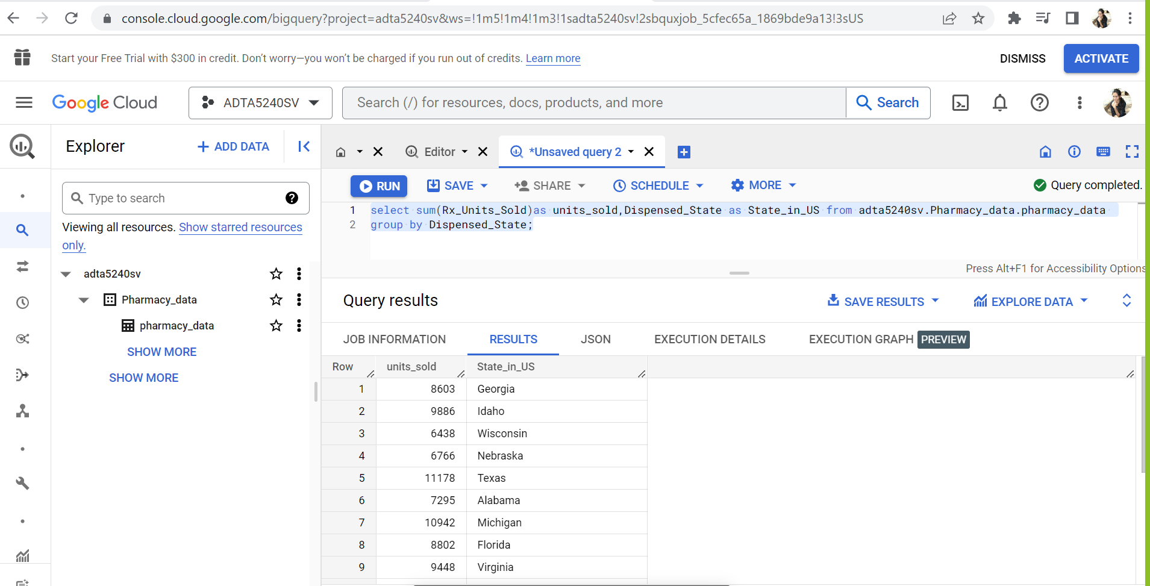
Query
Total of 22 columns in pharmacy table.
Modified our table based on required columns as per the visuals.

Slide 15
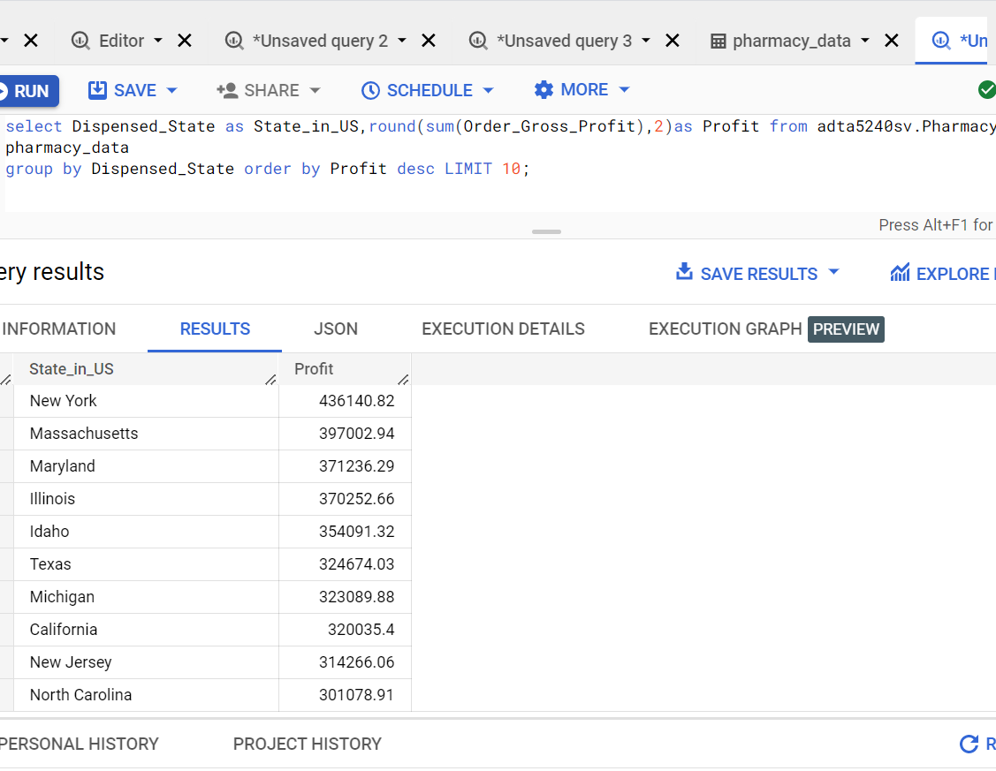
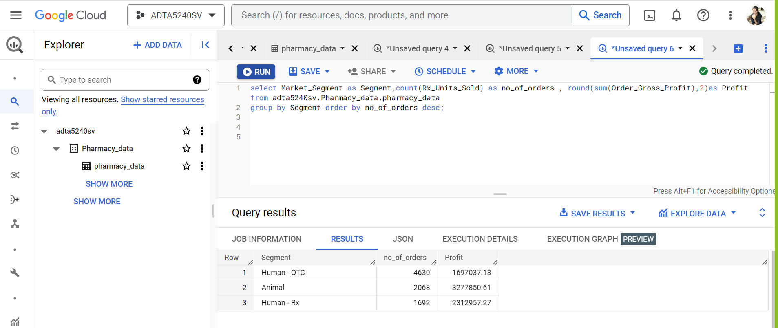
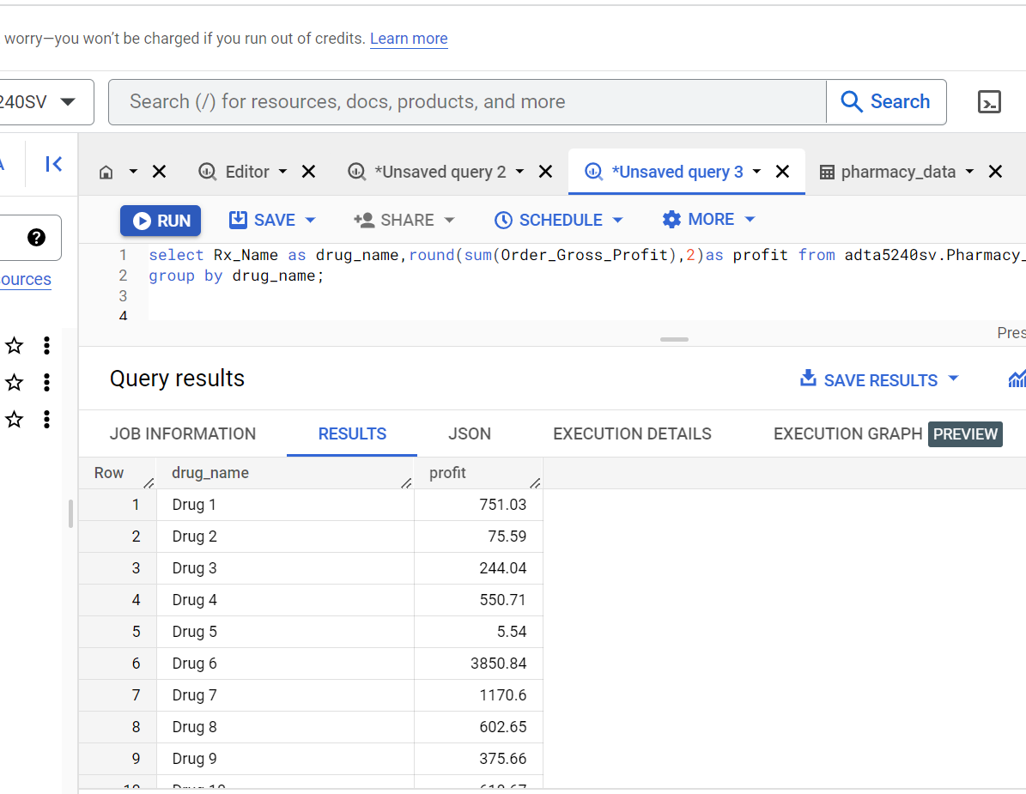
Query Cont

Slide 16
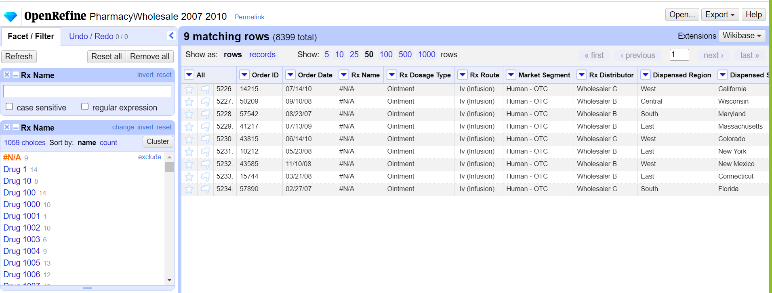
Open Refine Before We have removed NULL rows from the data sheet of column : RX Name using Open Refine to tune the accuracy of the data visualization.

Slide 17
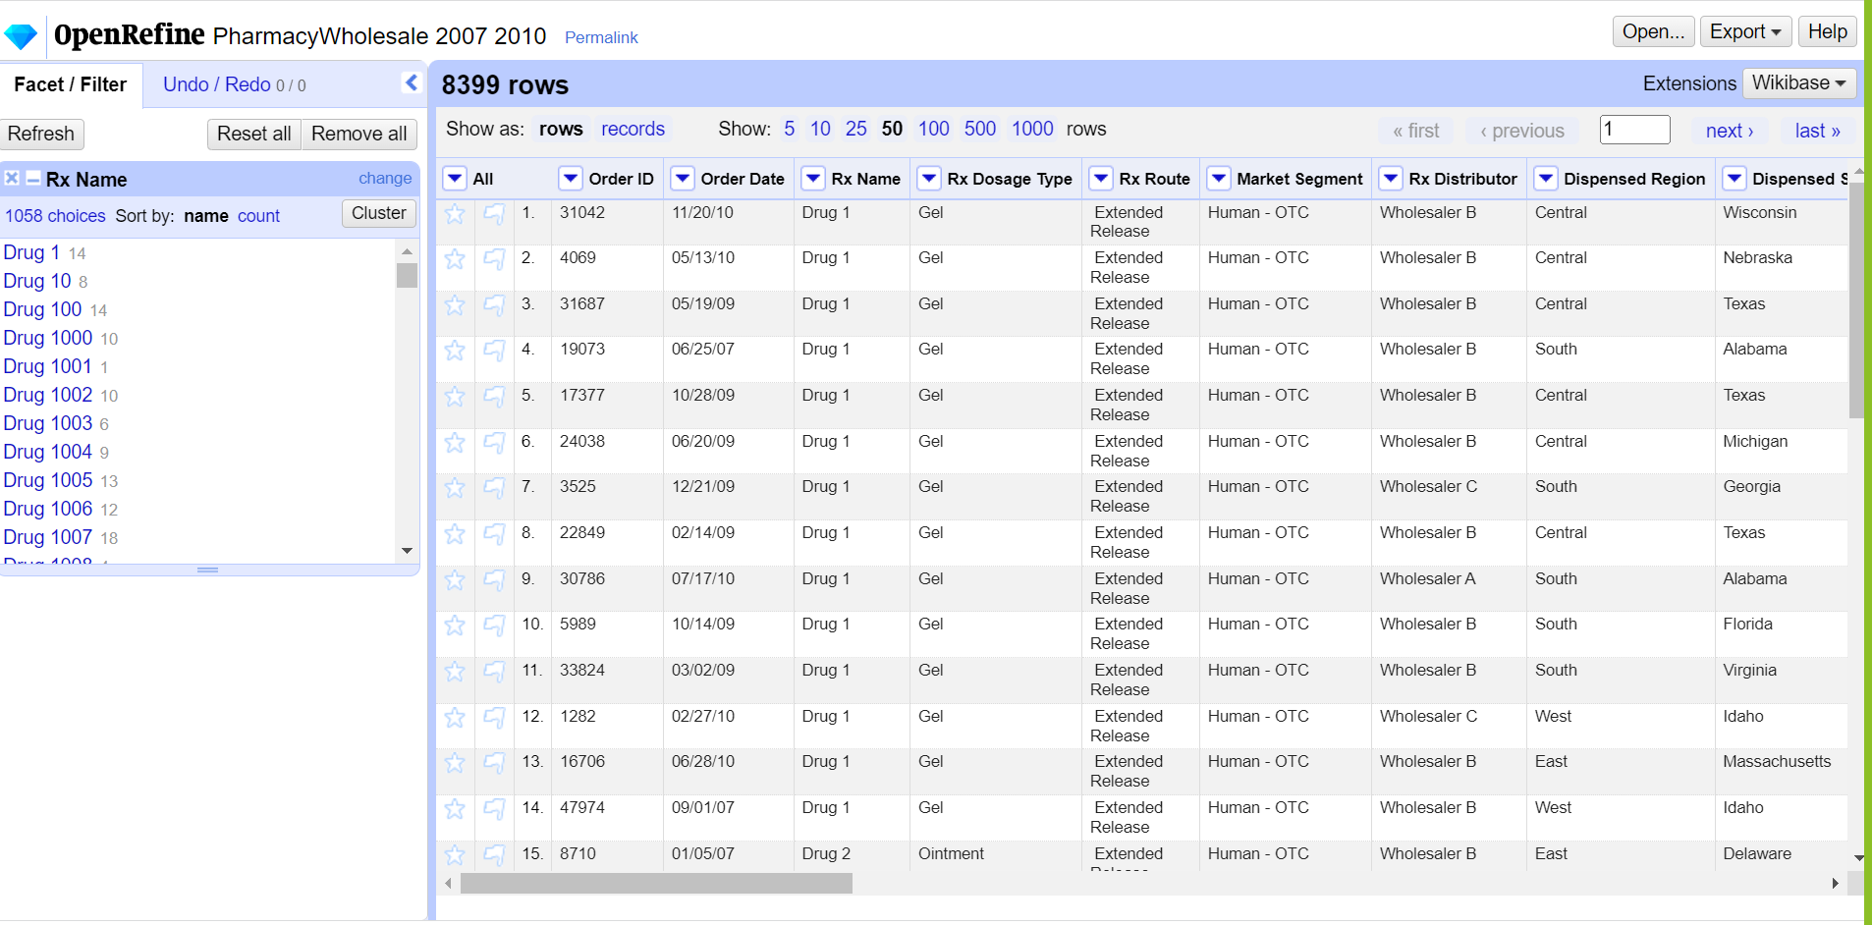
Open Refine After

Slide 18
Conclusion:
Based on the analysis conducted by our group, it is evident that the U.S. pharmacy industry has experienced a decline in overall profits from 2007 to 2010. However, there are several strategies that can be deployed to maximize profits and maintain financial stability:
Raise the unit retail sales price in Texas.
Wholesaler B should consider placing larger orders for the Animal segment.
Dispatch Pharmacy representative Mary Monton to Bill Barreto's region or increase the retail price per unit.

Slide 19

Questions ? Comments ?
We are happy to help you..

Slide 20

Thank You

